Slide 1
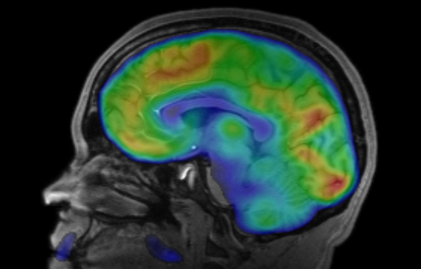
INTRO TO BRAIN IMAGING
February 5, 2020
Tom Morin

Slide 2
Agenda
How does MRI work?
Structural vs. Functional MRI
What is BOLD signal?
Three Ways to Look at fMRI Data
Activity Maps
Neural Decoding
Functional Connectivity Networks
The future…

Slide 3
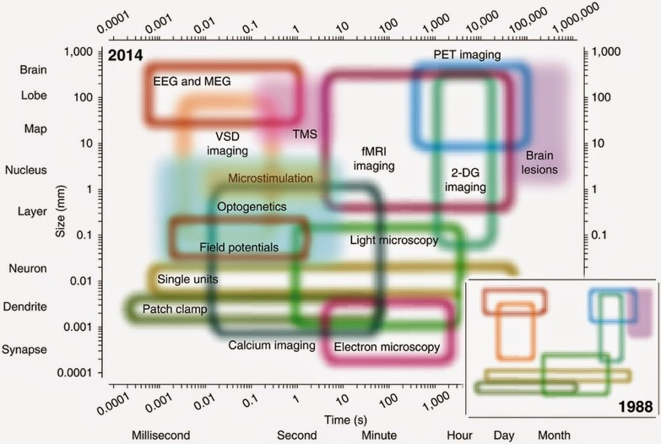
Temporal & Spatial Resolution
Sejnowski, et al. 2014

Slide 4
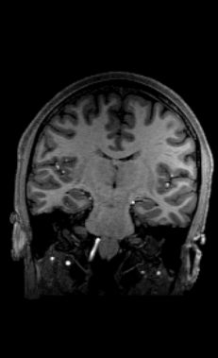
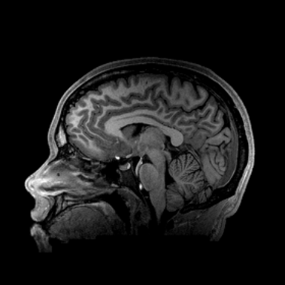
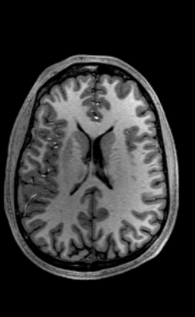
What am I Looking at?
Coronal
Sagittal
Axial

Slide 5
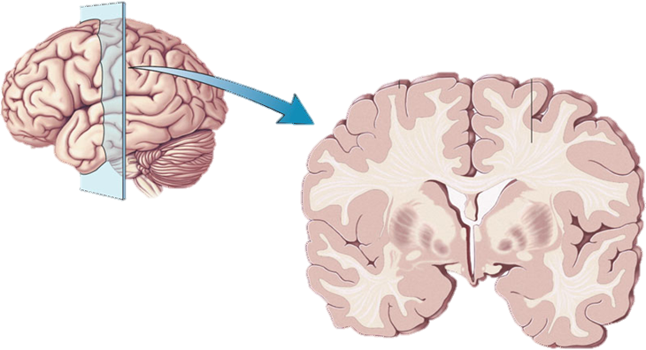
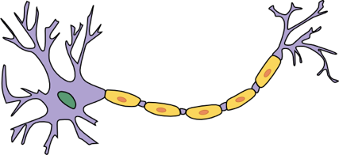
Quick Brain Anatomy Review
White Matter
Axon
Gray Matter
Cell Body

Slide 6
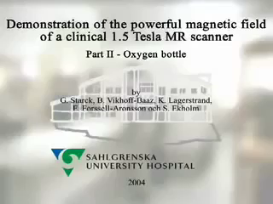
MR Safety
O₂ Tank vs. Watermelon: https://www.youtube.com/watch?v=plvIEf7JsKo

Slide 7

What Does MRI Sound Like?
MRI Sounds: https://www.youtube.com/watch?v=xS_V_OgeX-U

Slide 8
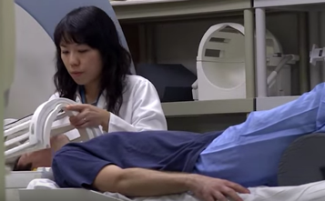
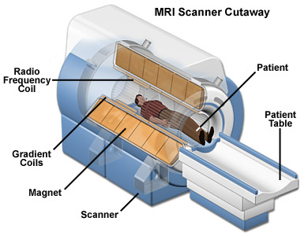
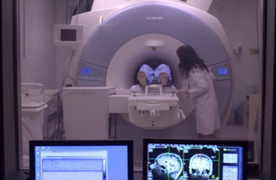
How Does MRI Work?
Notes:
https://www.youtube.com/watch?v=2COPkX5FUAI (2 min.)

Slide 9
Magnetic Resonance Imaging
Place subject in a strong magnetic field
Protons align to the direction of the field
Apply Magnetic Field
Notes:
1T is 50 million times more powerful than the Earth’s magnetic field
Clinical scanners are typically 1.5T.
Research scanners (for live humans) can go up to 7T.
These things cost about $1 million per Tesla

Slide 10
Magnetic Resonance Imaging
2. Apply a radiofrequency pulse, temporarily sending some protons into an excited state
Apply RF Pulse
Notes:
Swing-set analogy
“RESONANT” frequency of radiowaves targets specific

Slide 11
Magnetic Resonance Imaging
3. End the pulse, allowing protons to relax back
As they relax, the protons release energy in the form of radiowaves, that is detected by RF coils
End RF Pulse
Apply RF Pulse
Notes:
Swing-set analogy
“RESONANT” frequency of radiowaves targets specific

Slide 12
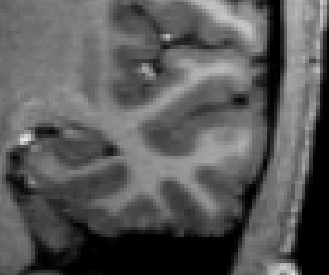
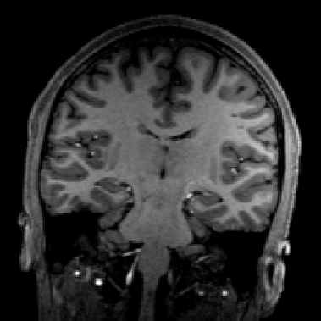
MR Signal Differs for Each Tissue
White Matter
Gray Matter

Slide 13
MR Signal Differs for Each Tissue
White Matter
Gray Matter

Slide 14
Agenda
How does MRI work?
Structural vs. Functional MRI
What is BOLD signal?
Three Ways to Look at fMRI Data
Activity Maps
Neural Decoding
Functional Connectivity Networks
The future…

Slide 15
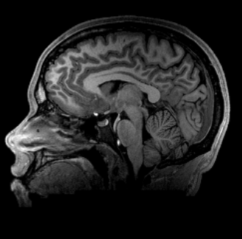
Structural MRI
5-10 minutes to acquire
~1mm resolution
3-Dimensional
Acquired in slices

Slide 16
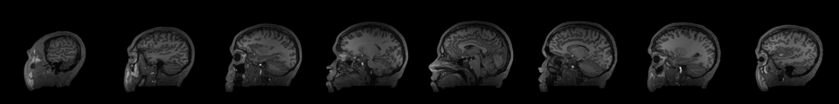
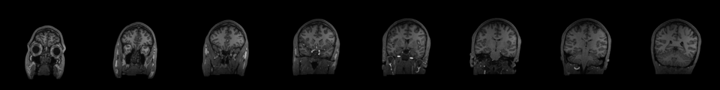
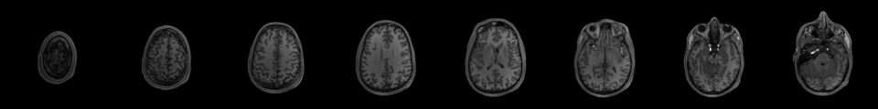
We Acquire One Slice at a Time
Online Example of Brain Slices:
http://www.tmmorin.com/brain_images/T1_june2016.html

Slide 17
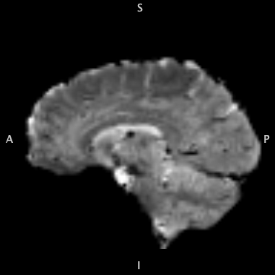
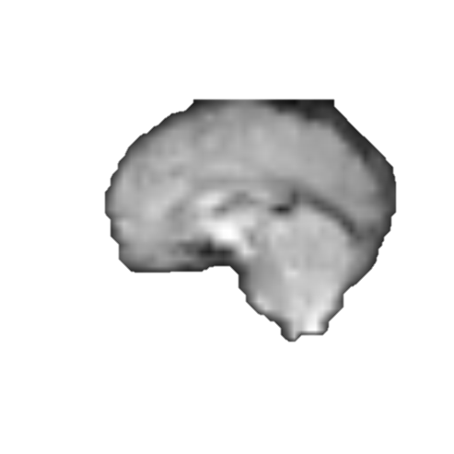
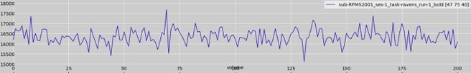
Functional MRI (fMRI)
Sped Up 20x
4D “Video” of BOLD signal
An entire brain scan is acquired every 2-3 seconds (sometimes faster)
Temporal Resolution:
500 – 3000ms
Spatial resolution:
~2-3mm³
Signal
time
Time

Slide 18
Blood Oxygen Level Dependent (BOLD) Signal
Active neurons require oxygen as fuel.
Brain regions with more oxyhemoglobin have increased BOLD signal and appear brighter.
Oxyhemoglobin is diamagnetic (not affected by the magnetic field), deoxyhemoglobin is paramagnetic
Stimulus
Neural Response
CBF
CBV
CMRO₂
BOLD Signal
Notes:
Neurons do not store internal reserves of glucose and oxygen, which are essential to their proper function.
Increases in neuronal activity, typically in response to a demand for information processing, require more glucose and oxygen to be rapidly delivered via the blood stream.
Via this hemodynamic response, blood releases glucose and oxygen to active neurons at a faster rate relative to inactive neurons.
This results in a surplus of oxyhemoglobin localized to the active area, giving rise to a measureable change in the local ration of oxy- to deoxyhemoglobin, thus providing a localizable marker of activity for MRI.

Slide 19
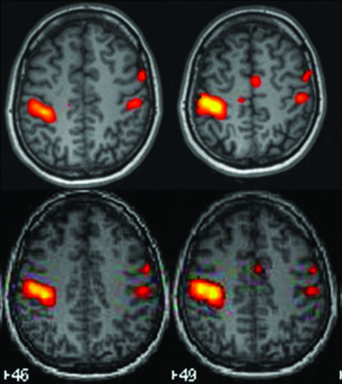
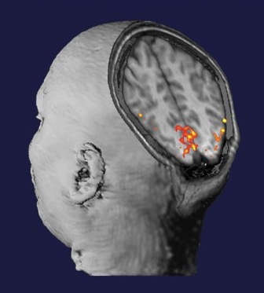
Functional MRI (fMRI)

Slide 20
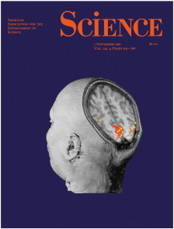
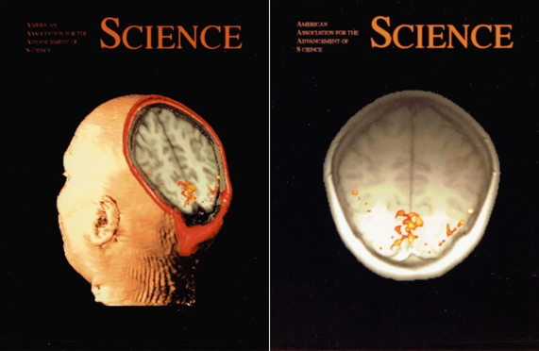
Aside: fMRI History
Much of the pioneering research for fMRI was conducted here in Boston at MGH
Published on the cover of Science in 1991
http://www.fmri25.org/behind-the-cover/

Slide 21
Agenda
How does MRI work?
Structural vs. Functional MRI
What is BOLD signal?
Three Ways to Look at fMRI Data
Activity Maps
Neural Decoding
Functional Connectivity Networks
The future…

Slide 22
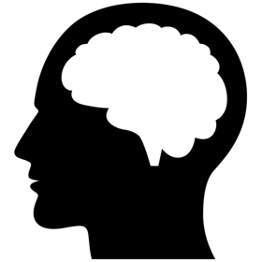
Image Subtraction
CONDITION A
-
CONDITION B
=
ACTIVATION MAP
A > B

Slide 23
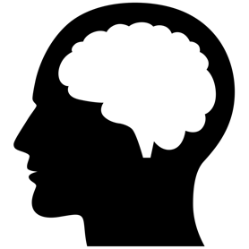
General Linear Model
Time
PERSON
CAT
Region 1
Region1 =
β_{P} * PERSON
+ β_{C} * CAT
β_{P} = 1.0
β_{C} = 0.0
β_{C}
β_{P}
-3
-2
-1
0
1
2
3

Slide 24
General Linear Model
Time
PERSON
CAT
Region 2
Region2 = β_{P} * PERSON + β_{C} * CAT
β_{P} = 0.0
β_{C} = 2.0
β_{C}
β_{P}
-3
-2
-1
0
1
2
3

Slide 25
General Linear Model
Time
PERSON
CAT
Region 3
Region3 = β_{P} * PERSON + β_{C} * CAT
β_{P} = 2.0
β_{C} = 0.5
β_{C}
β_{P}
-3
-2
-1
0
1
2
3

Slide 26
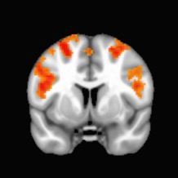
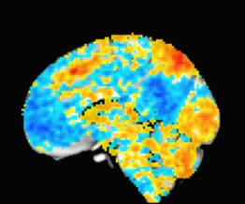
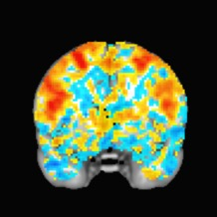
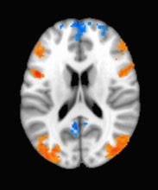
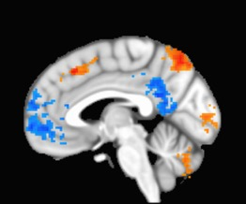
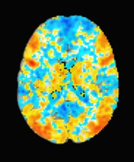
Thresholding the Image

Slide 27
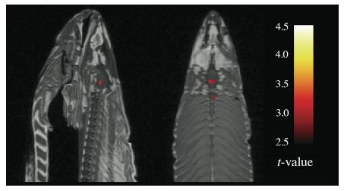
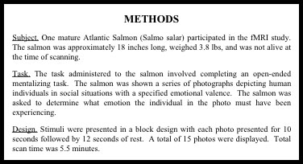
Limitations
fMRI is noisy! (you can have false positives)
Dead salmon shows “neural activity”
Bennett, et al. (2009)

Slide 28
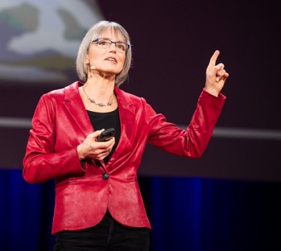
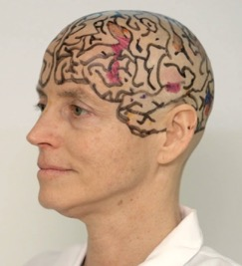
Finding Functional Brain Regions
Nancy Kanwisher, pioneering researcher in fMRI
Showed we can localize brain regions that show increased activation associated with a cognitive task

Slide 29
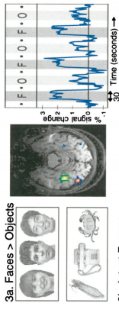
Finding Functional Brain Regions
Design a Task/Control Paradigm
Kanwisher, et al. (1997)

Slide 30
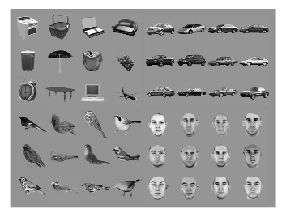
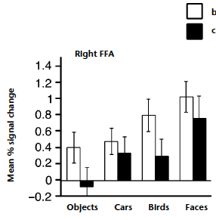
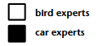
Is the FFA Face-Specific?
Car Experts & Bird Experts show increased FFA activation when viewing cars/birds compared to viewing objects
Gauthier, et al. (2000)

Slide 31
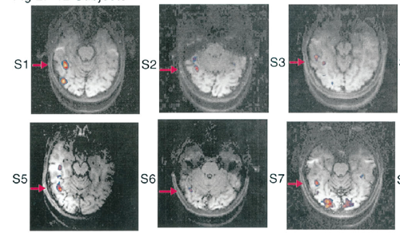
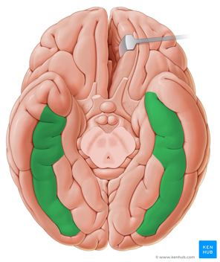
Functional vs. Anatomical Regions
Anatomical: Fusiform Gyrus
Functional: Fusiform Face Area
Kanwisher, et al. (1997)
kenhub.com

Slide 32
Limitations
This is “macro” imaging
Our best resolution is about 1mm³
About half a billion synapses per voxel
The temporal resolution fMRI is in seconds
EEG can measure brain activity in milliseconds
Neurons can fire hundreds of times per second
Participants are lying down in a dark, loud, crammed tunnel

Slide 33
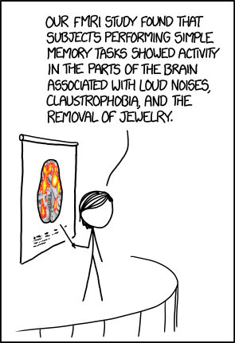
Forum Responses
Response from Last Year: “While I've never had a MRI before I've heard that they're both incredibly loud and time consuming. … I'm wondering if [Kanwisher’s] studies take into account the distractions of the noise of the MRI and the overall feeling of being in an MRI machine. These could possibly be confounding variables that affect her study.”

Slide 34
Agenda
How does MRI work?
Structural vs. Functional MRI
What is BOLD signal?
Three Ways to Look at fMRI Data
Activity Maps
Neural Decoding
Functional Connectivity Networks
The future…

Slide 35
Neural Decoding
Described in the homework reading
Also known as:
Multivoxel Pattern Analysis (MVPA)

Slide 36
Neural Decoding Analogy: Audience Applause
Section 1
Section 2
Section 3
Candidate 1
Candidate 2
Candidate 3
Mystery Candidate???:
Applause
Applause
Applause
Applause
0
1
2
3
0
1
2
3
0
1
2
3
0
1
2
3
Section
Section
Section
Section

Slide 37
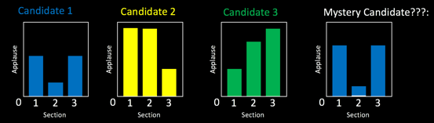
Neural Decoding Analogy
Audience Sections = Brain Regions
Candidates = Stimuli
Applause Levels = Brain Activation (BOLD signal)
Graphs = Activity Patterns
Training Set:
Test:
Section 1
Section 2
Section 3

Slide 38
Neural Decoding
TRAINING SET:
TEST ITEM:
BOLD Signal
BOLD Signal
Brain Region
Brain Region
?
BOLD Signal
Brain Region

Slide 39
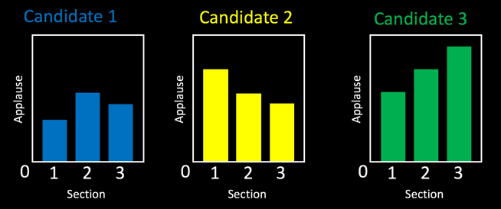
Sensitivity Analysis
Run the neural decoding analysis many times
Each time, “perturb” activity in a different brain region, and see how it affects the results (drown out applause in one audience section)
If this worsens the decoding, then this region is important for representing information about these stimuli
For example, removing section 1 in the plots below makes it difficult to differentiate Candidate 2 from Candidate 3.

Slide 40
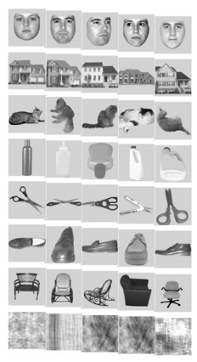
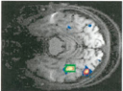
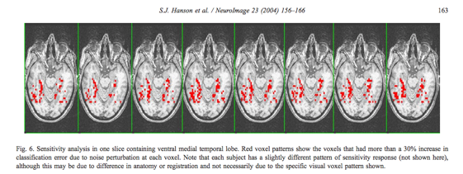
Neural Decoding Example
Hanson, et al. (2001) conducted a neural decoding analysis on faces, objects, houses, etc.
Found that FFA activity contains information about these different categories
Kanwisher, et al. (1997)

Slide 41
Issues surrounding Neural Decoding & Machine Learning
Are certain applications ethical (or even possible)?
Lie Detection?
Detection of “true” pain?
Detection of consciousness in coma patients?
Training Data has a huge influence
Algorithms are best if trained on individual subjects
Like any machine-learning project, a diverse training dataset is necessary

Slide 42
Agenda
How does MRI work?
Structural vs. Functional MRI
What is BOLD signal?
Three Ways to Look at fMRI Data
Activity Maps
Neural Decoding
Functional Connectivity Networks
The future…

Slide 43
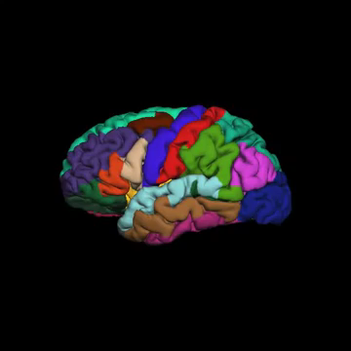
Aside: Cortical Surface
https://www.youtube.com/watch?v=aj-d8PZMXt8

Slide 44
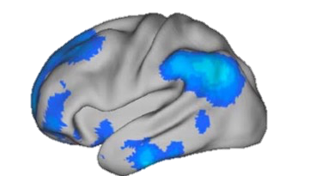
Functional Connectivity
How do spontaneous fluctuations in BOLD signal correlate between brain regions?

Slide 45

Functional Connectivity Networks
Yeo, et al. 2011

Slide 46

Functional Connectivity Networks
Yeo 7 Network Parcellation
Schaefer, et al. 2018

Slide 47

Context Dependent Rule Learning Task
Research Question: How does the brain’s functional network structure support rule-learning?
Task: Learn which pairs of objects go together during fMRI scanning.

Slide 48


Correct
Incorrect
Pair?

Slide 49


Learning Varies Across Subjects
Overall Accuracy
Accuracy for Each Scan Run

Slide 50

Brain Networks During Learning
Nodes: 400 brain regions
Edges: Pearson Correlation, of BOLD signal between regions
Decoration: Color, based on Functional Connectivity Network Membership
Repeated for each of 9 scanning runs, and for each of 30 subjects

Slide 51



Empirical Questions
During the rule learning task, which brain regions play a “central role”?
Regions that are central to the network integrate information from many other regions.
It’s possible that central regions are important for coordinating a strategy.
Does this differ between successful and unsuccessful learners?

Slide 52
Betweenness Centrality
Centrality Points
|
|
|

Slide 53

Centrality of the Cognitive Control Network During Rule Learning

Slide 54



Centrality and Rule Learning

Slide 55
Preliminary Takeaways
Overall, all brain regions are more central in successful learners, suggesting stronger overall functional connectivity
Cognitive Control Network is more central early on during for successful learners
This could indicate that the Cognitive Control Network is important for forming a strategy
Once the task becomes automatic, the CCN can take a back-seat

Slide 56
Limitations of Network Science Methods
Network statistics is a new field and the correct mathematical methods are not quite settled:
These methods are computationally complex, requiring advanced computers for large datasets
As a correlational measure, functional connectivity must be interpreted carefully (What does it mean for two regions to be “functionally connected”?)

Slide 57
Agenda
How does MRI work?
Structural vs. Functional MRI
What is BOLD signal?
Three Ways to Look at fMRI Data
Activity Maps
Neural Decoding
Functional Connectivity Networks
The future…

Slide 58


The Future is Now
Dylan Williams, 21 year-old student at Tufts in 2012 when he was hit by a car
Deemed “minimally conscious” by physicians at MGH
Dr. Brian Edlow was conducting research at the time imaging unconscious individuals with fMRI
Brain responded to music and language sounds
Dylan regained consciousness a few days later
https://giving.massgeneral.org/fmri-reveals-brains-secrets/

Slide 59



Acknowledgements
Boston University
Dr. Chantal Stern
Dr. David Somers
Dr. Shelley Russek
Rachel Nauer
Allen Chang
Matt Dunne
Stamati Liapis
Kylie Moore
Caroline Ahn
Weida Ma
MGH Martinos Center
Dr. Jacob Hooker
Dr. Hsiao-Ying (Monica) Wey
Dr. Nicole Zürcher Dr. Martin Strebl
Dr. Tonya Gilbert
Christine Wu
Baleigh Hightower
Tufts University
Dr. Aniruddh Patel
Dr. Ayanna Thomas
Dr. Ben Hescott
Dr. Elizabeth Race
Dr. Nathan Ward

Slide 60
Questions?
www.tmmorin.com
tommorin@bu.edu

